Slide 1

IDENTIFICATION OF VISITOR USING LASER LIGHT

Slide 2
TEAM MEMBERS
R.ROHAN (2110040071)
T.NITHISH (2110040110)
K.SATHISH (2110040075)
K.SRIHARSH (2110040115)
B.SAKETH (2110040112)
E.PRAMOD (2110040013)
K.SATHWIK GOUD (2110040065)
V.PAVAN KUMAR (2110040076)
P.MEGA SHYAM (2110040068)

Slide 3
content
INTRODUCTION
COMPONENTS/MATERIALS REQUIRED
CIRCUIT DIAGRAM
EXPERIMENTAL SETUP
WORKING
USES OF LASER SECURITY ALARM SYSYTEM
ADVANTAGES
CONCLUSION

Slide 4
INTRODUCTION
Security is the most important factor today.Technology develops day by day in the world .the crime gangs also improves their technology to perform the operation.
so, technology of security should be modern with time to protect the crime works.we decide to make a security .
project as our project in this project we have used the weather light to cover a large area .
we know laser light goes through long distance without scattering effect.its also visible at source and at incident point,otherwise invisible.

Slide 5
These 2 properties help us to build up a Modern security system which may name as “laser security” .
when any personal object or cross over the laser lines the security alarm will ring and also the focus light bill on to forecast the entrance of unauthorised person .we can make a security boundary of single laser light by using mirror at every corner for reflection

Slide 6
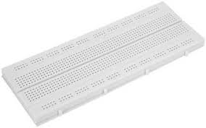
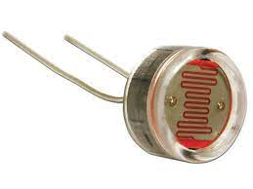
Components required
Breadboard: A breadboard also known as protoboard is atype of solder less electronic circuit building. You can build a electronic circuit on the breadboard without any soldering !Best of all it is re2.
LDR: A photo resistor is also called light dependent resistor or photocell is a light controlled variable resistor. The resistance of a photo resistor decreases with i intensity in other words, it exhibits

Slide 7
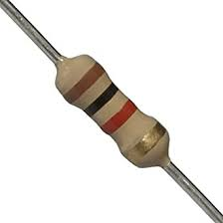
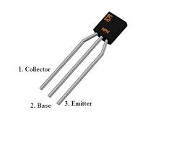
Resistor: A resistor is an electrical component that limits or regulates the flow of electrical current in an electric circuit. Resistors can also be used to provide a specific voltage for an active device suas an transistor.
NPN Transistor: NPN is or transistor consisting of a layer of P-doped semiconductor(the "base", between two N-doped layers. A small current entering the base is amplified to produce a large collector and emitter current.

Slide 8
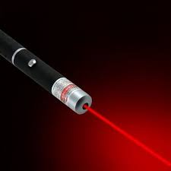
Laser Pointer: A laser pointer or laser pen is a small handheld device with a power source and a laser diode emitting a very narrow coherent low powered laser beam of visible light.
LED: A light emitting device emits visible light through it.

Slide 9
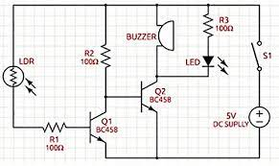
Circuit diagram

Slide 10
EXPERIMENTAL SETUP
Connect a photocell to a 5K resistor. This will pick up the laser and enable the alarm.
Use a 2N7000 transistor to link the resistor. The attached schematic should demonstrate how the parts come together. Use a breadboard to hold them in place and make sure the board is small enough to fit into a project box. Do not connect the battery yet.
Use tape, glue or strips to Velcro to mount the project box on either side of the door you wish to protect.
Connect a 9V battery to the first project box and replace it in the exact position is was in.
Turn the laser on with the toggle switch and make sure it lines up perfectly with the photo cell. The alarm is now activated. If any thing breaks the beam, the siren will go off.

Slide 11
WORKING
This circuit is based on LDR (Light Depended Resistor), variable resistor in which the resistance varies according to the light intensity falling on it.
LDR and resistor R1 forms a potential driver network which is the main part of our security alarm circuit.
We have already discussed about how transistor acts as a switch, the same principle is used here.
The voltage drop across the LDR is used t drive the transistor switch. When the voltage drop is above cut in voltage(0.6v), the transistor is turn ON.
LDR has low resistance in the presence of lightand high resistance in the absence of light.In our security alarm, a laser light is allowed tofall on the LDR continuously using 3 mirrors.
Light from another source should not allowed to fall on the LDR, so place the LDR in a box with a single hole to pass laser.
In this situation the resistance offered by LDR istoo low. Since the LASER light is continuously.
In this situation the resistance offered by LDR is too low.Since the LASER light is continuously allowed to fall on the LDR surface.

Slide 12
USES & ADVANTAGES
Laser security system locks working: Laser door alarm is based on the interruption of laser beam. The laser pointer is used as the source of light beam.
Laser system:Laser technology products will calculate distance by measuring the time of flight of very short infrared light
Theft detection by laser system:It can be design as a simple electronic project for demonstration in science exhibition. It can also be made as a mini or major project for electrical or electronic students.
Other uses of laser system :The laser security system are high tech innovations that have gained popularity in home and office security system.

Slide 13
CONCLUSION
Home security is rapidly growing field and there are new & improved burglar alarms popping up everyday.
With rapid advancement of technology the field is turning out to be an area full of scope and new changes can be made to make it's more efficient.
It has years to come, because security is of prime importance to one and all.

Slide 14
THANK YOU

